Slide 1


Automatic Bank Form Generation System Based on IVRS

Slide 2


MVGR COLLEGE OF ENGINEERING (Autonomous)
DEPARTMENT OF COMPUTER SCIENCE AND ENGINEERING
Batch : 15
Mentor: Dr P. Ravi Kiran Varma sir
Team Members :
K. Harshitha - 19331A0579
M. J. Rohit Varma - 19331A05A3
K. Divya Satya Kumari - 19331A0592
Md Imran - 20335A0509

Slide 3
Motivation:
This will help the people not depend on strangers for their financial work.
It also saves their valuable time which is consumed in manually filling the forms.
This software will help them get the forms faster without any difficulties

Slide 4
The proposed solution:
A software which generates the deposit form or withdrawal form with all the necessary details filled automatically.
The account number is fetched by scanning the barcode present on the passbook.
Rest of the details like name, branch, etc. related to the account number are fetched from the database and filled into the form automatically.
The deposit/withdrawal amount field is filled based on the requirements given through voice command by the customer.

Slide 5
Objectives :
Create a user friendly software which interacts with the user like a real human.
The software should be able to receive the inputs exactly as given by the user.
The software should select the required form (deposit or withdrawal) according to the user requirement.
The software should fill the from according to the inputs given by the user and the data fetched from the database.

Slide 6
Technologies Required
Programming Language: Python 3.9
IDE used: VS Code, Spyder
Packages used:
Speech Recognition (recognize_google)
Pyzbar
OpenCV
Selenium and webdriver
Chrome Driver
gTTS(Google text to speech)
Googletrans (for translation)
Playsound

Slide 7
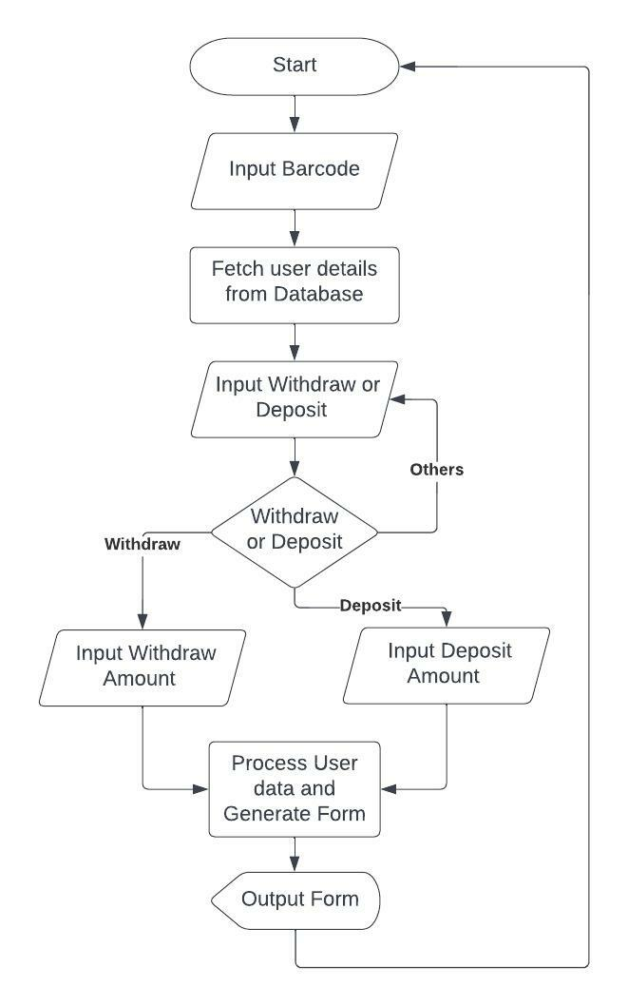
Program Flow:

Slide 8
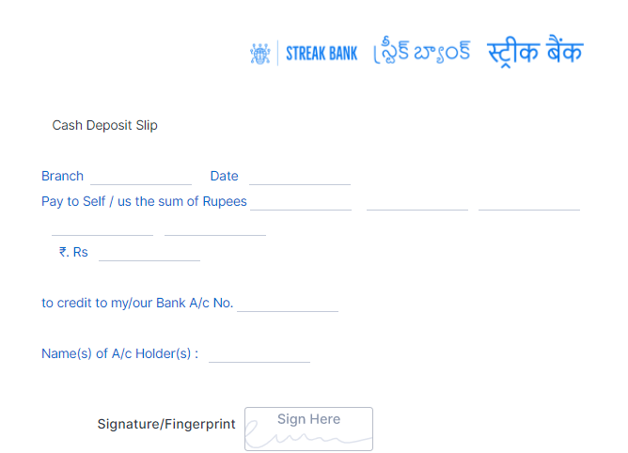
Deposit Form :

Slide 9
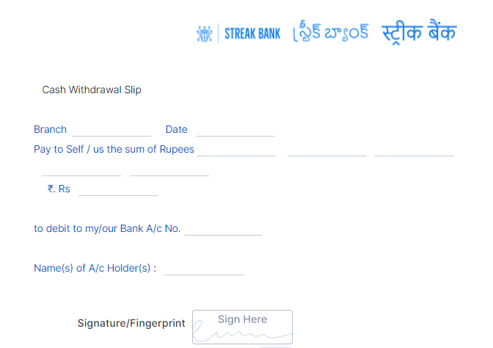
Withdrawal Form :

Slide 10


